Slide 1

Lecture 7:
Power

Slide 2
Outline
Power and Energy
Dynamic Power
Static Power
7: Power

Slide 3

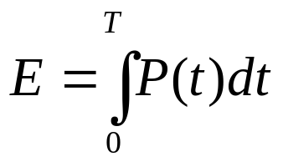
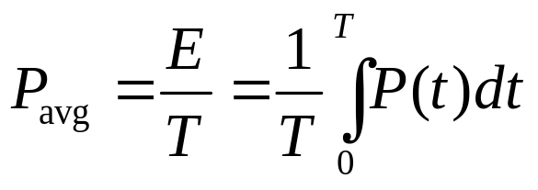
Power and Energy
Power is drawn from a voltage source attached to the V_{DD} pin(s) of a chip.
Instantaneous Power:
Energy:
Average Power:
7: Power

Slide 4
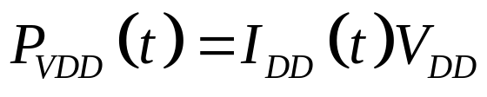
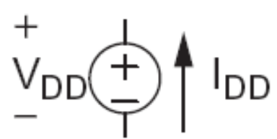
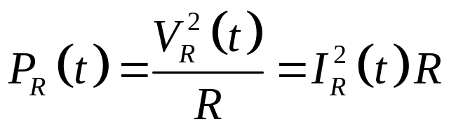
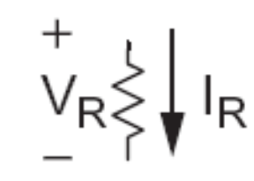
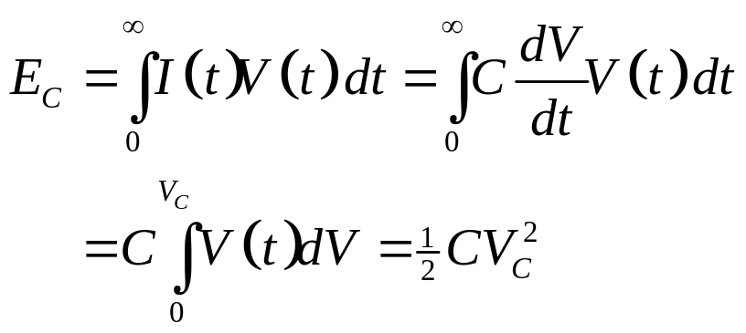

Power in Circuit Elements
7: Power

Slide 5
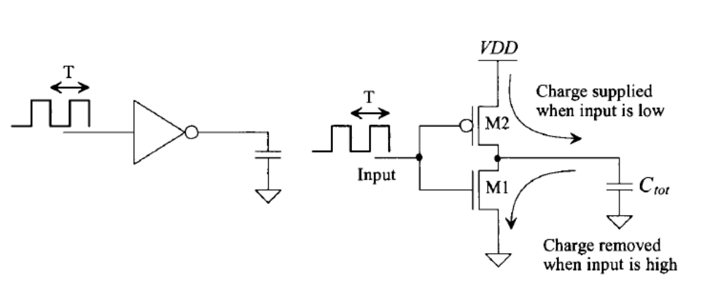
Dynamic power dissipation
7: Power

Slide 6
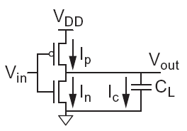

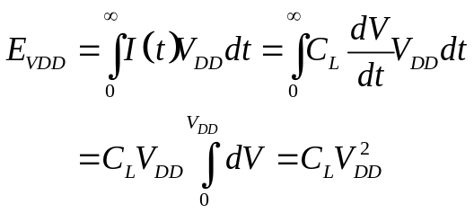
Charging a Capacitor
When the gate output rises
  Energy stored in capacitor is
  But energy drawn from the supply is
  Half the energy from V_{DD} is dissipated in the pMOS transistor as heat, other half stored in capacitor
When the gate output falls
  Energy in capacitor is dumped to GND
  Dissipated as heat in the nMOS transistor
7: Power

Slide 7
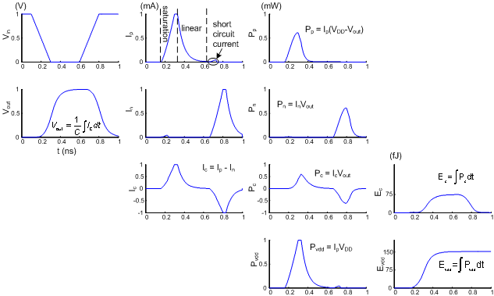
Switching Waveforms
Example: V_{DD} = 1.0 V, C_{L} = 150 fF, f = 1 GHz
7: Power

Slide 8
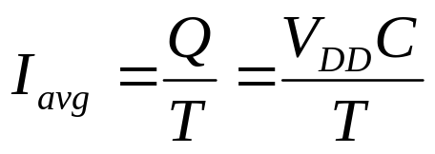
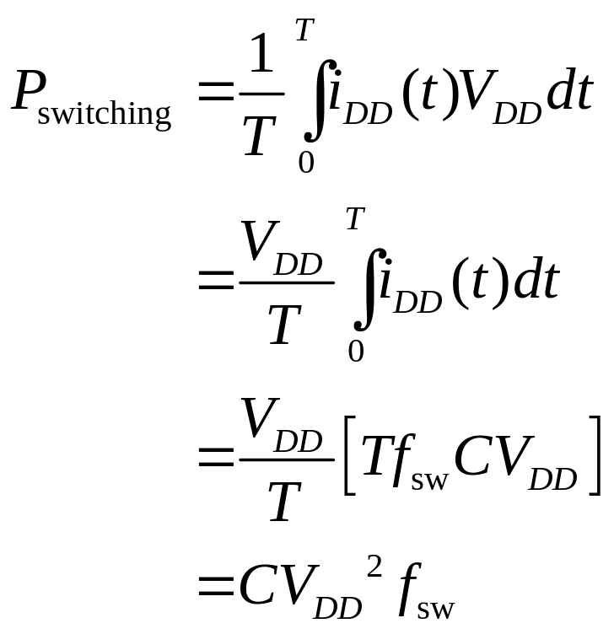
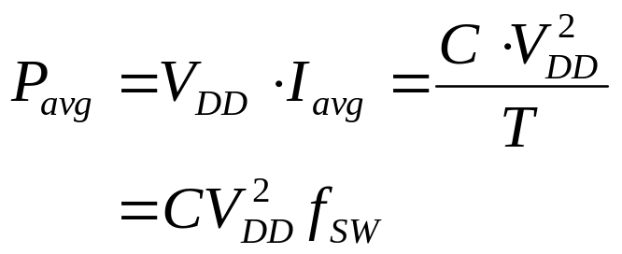
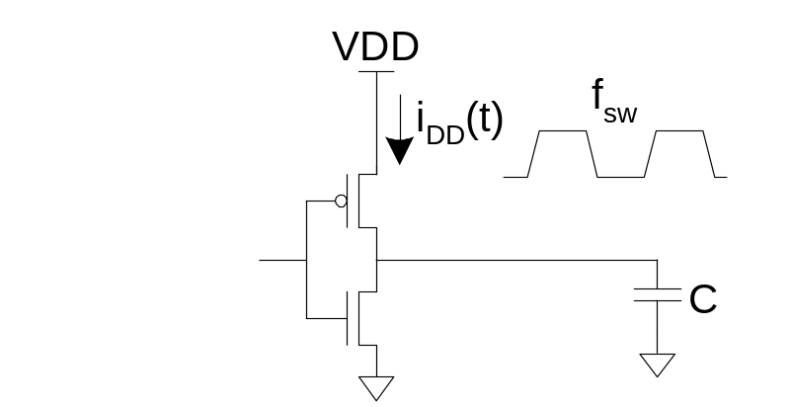
Switching Power
7: Power

Slide 9
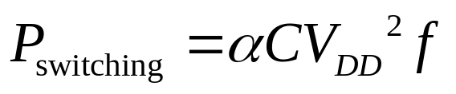
Activity Factor
Suppose the system clock frequency = f
Let f_{sw} = αf, where α = activity factor
  If the signal is a clock, α = 1
  If the signal switches once per cycle, α = ½
Dynamic power:
7: Power

Slide 10
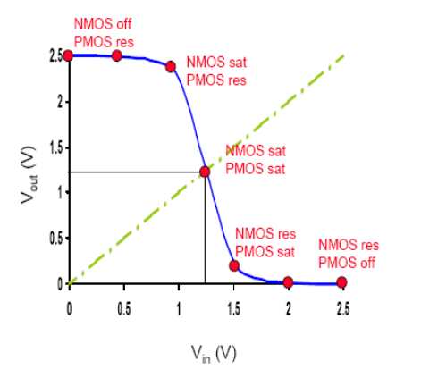
Short Circuit Current
When transistors switch, both nMOS and pMOS networks may be momentarily ON at once
Leads to a blip of “short circuit” current.
< 10% of dynamic power if rise/fall times are comparable for input and output
We will generally ignore this component
7: Power

Slide 11
Power Dissipation Sources
P_{total} = P_{dynamic} + P_{static}
Dynamic power: P_{dynamic} = P_{switching} + P_{shortcircuit}
  Switching load capacitances
  Short-circuit current
Static power: P_{static} = (I_{sub} + I_{gate} + I_{junct} + I_{contention})V_{DD}
  Subthreshold leakage
  Gate leakage
  Junction leakage
  Contention current
  in rationed circuits
Tunnel current
polysilicon
gate
W
t
ox
n+
L
n+
Subthreshold conduction
p-type body
Junction leakage
7: Power
Notes:
For example,
pseudo-nMOS gates discussed in Section 9.2.2 experience contention between the nMOS
pulldowns and the always-on pMOS pullups when the output is 0

Slide 12
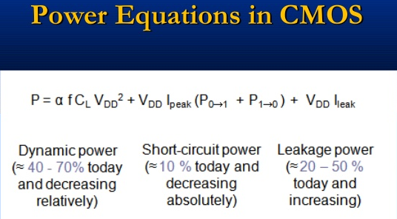
Power equations in CMOS
7: Power

Slide 13
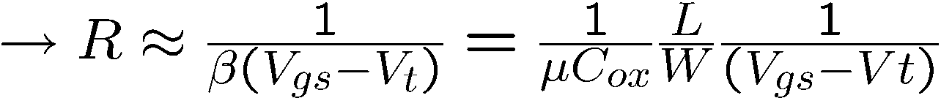
Dynamic Power Example
1 billion transistor chip
  50M logic transistors
    Average width: 12 λ
    Activity factor = 0.1
  950M memory transistors
    Average width: 4 λ
    Activity factor = 0.02
  1.0 V 65 nm process
  C = 1 fF/μm (gate) + 0.8 fF/μm (diffusion)
Estimate dynamic power consumption @ 1 GHz. Neglect wire capacitance and short-circuit current.
7: Power

Slide 14
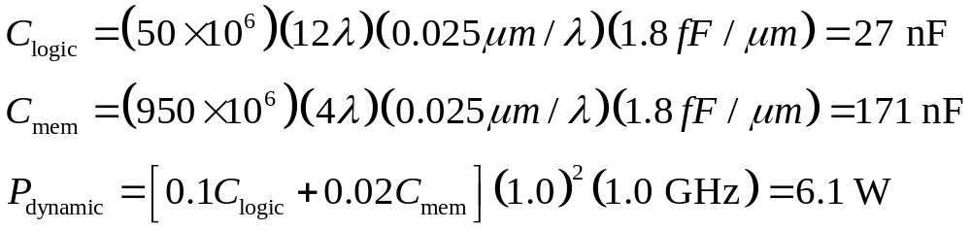
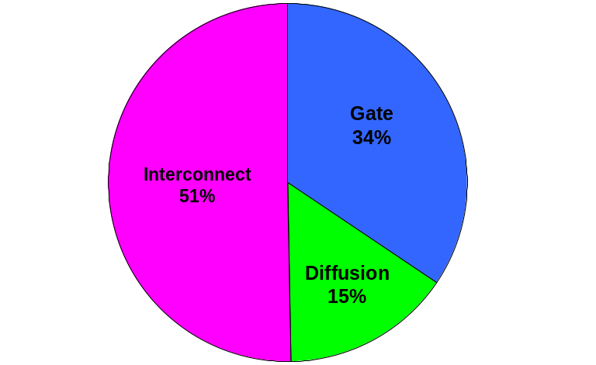
Solution
Total dynamic Power
[source: Intel’03]
7: Power

Slide 15
Dynamic Power Reduction
Try to minimize:
  Activity factor
  Capacitance
  Supply voltage
  Frequency
Clock
Enable
Clock Gating
I₁
O₁
I₂
I₃
I₄
I₅
O₂
I₆
critical
path
only reduce supply voltage of non critical gates
7: Power

Slide 16
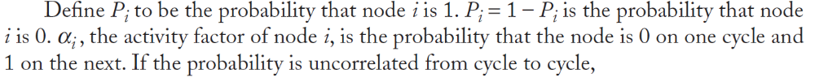
Activity Factor Estimation
Let P_{i} = Prob(node i = 1)
  P_{i} = 1-P_{i}
α_{i} = P_{i} * P_{i}
Completely random data has P = 0.5 and α = 0.25
Data is often not completely random
  e.g. upper bits of 64-bit words representing bank account balances are usually 0
Data propagating through ANDs and ORs has lower activity factor
  Depends on design, but typically α ≈ 0.1
7: Power

Slide 17

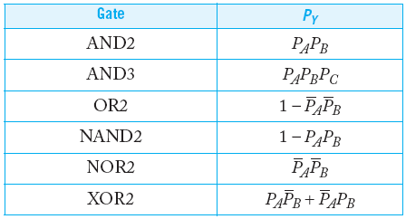

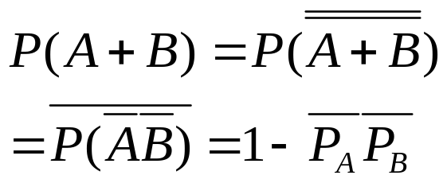
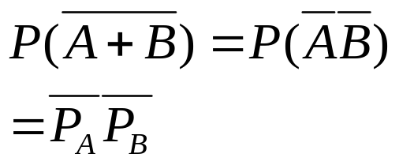
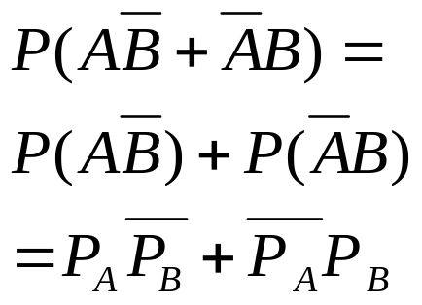
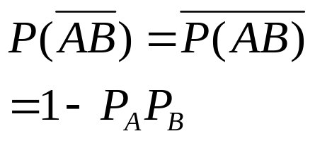
Switching Probability
7: Power

Slide 18
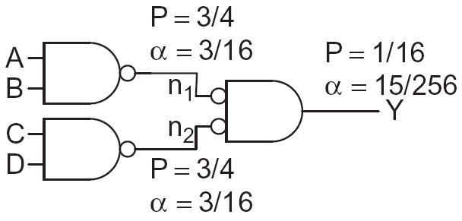
Example
A 4-input AND is built out of two levels of gates
Estimate the activity factor at each node if the inputs have P = 0.5
7: Power

Slide 19
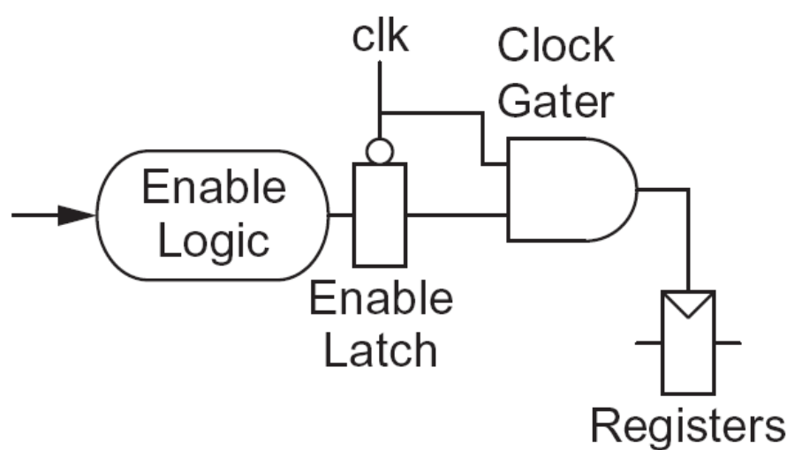
Clock Gating
The best way to reduce the activity is to turn off the clock to registers in unused blocks
  Saves clock activity (α = 1)
  Eliminates all switching activity in the block
  Requires determining if block will be used
7: Power

Slide 20
Capacitance
Gate capacitance
  Fewer stages of logic
  Small gate sizes
Wire capacitance
  Good floorplanning to keep communicating blocks close to each other
  Drive long wires with inverters or buffers rather than complex gates
7: Power

Slide 21
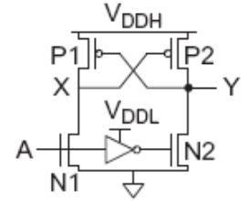
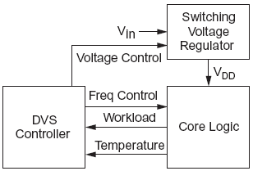
Voltage / Frequency
Run each block at the lowest possible voltage and frequency that meets performance requirements
Voltage Domains
  Provide separate supplies to different blocks
  Level converters required when crossing
  from low to high V_{DD} domains
Dynamic Voltage Scaling
  Adjust V_{DD} and f according to
  workload
7: Power

Slide 22
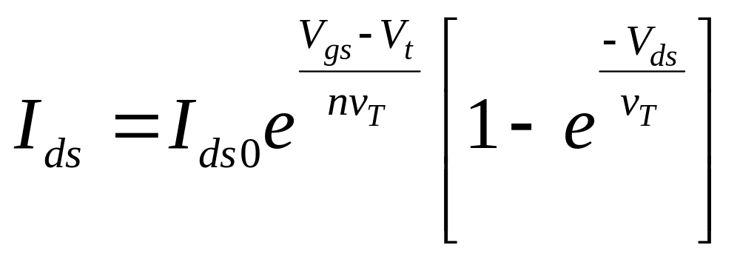



Static Power
Static power is consumed even when chip is quiescent.
  Leakage draws power from nominally OFF devices
  Ratioed circuits burn power in fight between ON transistors
7: Power

Slide 23
Static Power Example
Revisit power estimation for 1 billion transistor chip
Estimate static power consumption
  Subthreshold leakage
    Normal V_{t}: 100 nA/μm
    High V_{t}: 10 nA/μm
    High V_{t} used in all memories and in 95% of logic gates
  Gate leakage 5 nA/μm
  Junction leakage negligible
7: Power

Slide 24
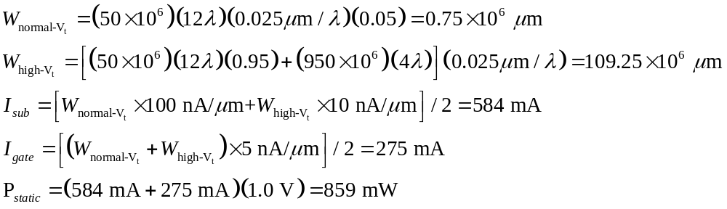
Solution
7: Power

Slide 25
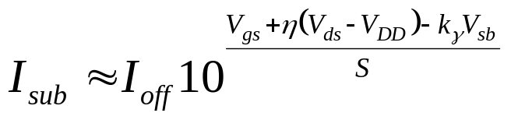
Subthreshold Leakage
For V_{ds} > 50 mV
I_{off} = leakage at V_{gs} = 0, V_{ds} = V_{DD}
Typical values in 65 nm
I_{off} = 100 nA/μm @ V_{t} = 0.3 V
I_{off} = 10 nA/μm @ V_{t} = 0.4 V
I_{off} = 1 nA/μm @ V_{t} = 0.5 V
η = 0.1
k_{γ} = 0.1
S = 100 mV/decade
7: Power

Slide 26
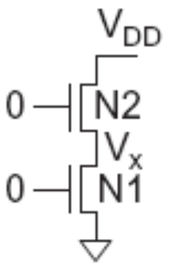
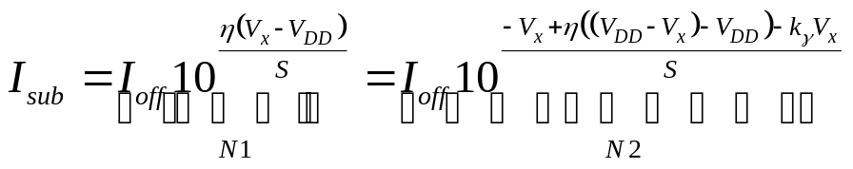
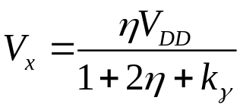
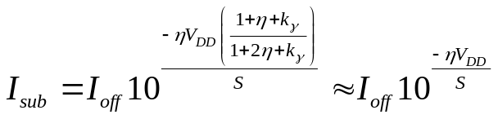
Stack Effect
Series OFF transistors have less leakage
  V_{x} > 0, so N2 has negative V_{gs}
  Leakage through 2-stack reduces ~10x
  Leakage through 3-stack reduces further
η = 0.1
V_{DD}=1.0 V
S = 100 mV/decade
7: Power

Slide 27
Threshold current control
Low V_{th} devices switch faster, and are therefore useful on critical delay paths to minimize clock periods R=
The penalty is that low V_{th} devices have substantially higher static leakage power
High V_{th} devices are used on non-critical paths to reduce static leakage power without incurring a delay penalty
Typical high V_{th} devices reduce static leakage by 10 times compared with low V_{th} devices
One method of creating devices with multiple threshold voltages is to apply different bias voltages (V_{b}) to the base or bulk terminal of the transistors.
Other methods involve adjusting the gate oxide thickness, gate oxide dielectric constant (material type), or dopant concentration in the channel region beneath the gate oxide
7: Power

Slide 28

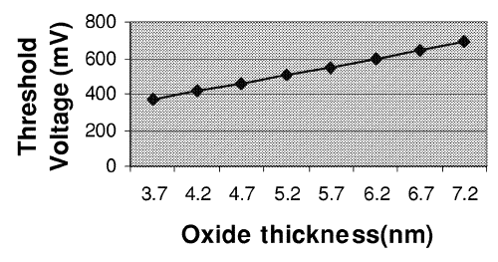
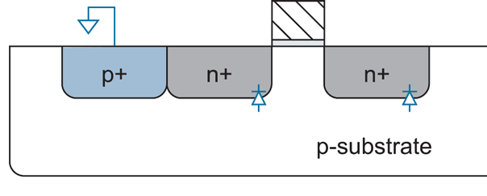
Leakage Control
γ = body effect coefficient
Leakage and delay trade off
  Aim for low leakage in sleep and low delay in active mode
To reduce leakage:
  Increase V_{t}: multiple V_{t}
    Use low V_{t} only in critical circuits
  Increase V_{s}: stack effect
    Input vector control in sleep
  Decrease V_{b}
    Reverse body bias in sleep(increase V_{t})
    Or forward body bias in active mode(decrease V_{t} )
2. Body Bias
φ_{s} = surface potential at threshold
7: Power

Slide 29
Gate Leakage
Extremely strong function of t_{ox} and V_{gs}
  Negligible for older processes
  Approaches subthreshold leakage at 65 nm and below in some processes
An order of magnitude less for pMOS than nMOS
Control leakage in the process using t_{ox} > 10.5 Å
  High-k gate dielectrics help
  Some processes provide multiple t_{ox}
    e.g. thicker oxide for 3.3 V I/O transistors
Control leakage in circuits by limiting V_{DD}
7: Power
Notes:
Tunneling current can be an order of magnitude higher for nMOS than pMOS transistors
with SiO2 gate dielectrics because the electrons tunnel from the conduction band
while the holes tunnel from the valence band and see a higher barrier

Slide 30
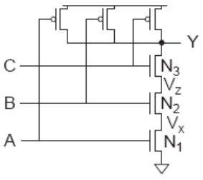
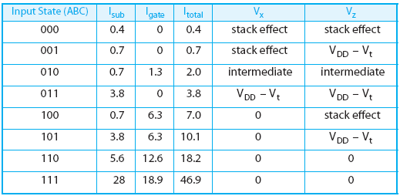
NAND3 Leakage Example
100 nm process
  Gate leakage: I_{gn} = 6.3 nA I_{gp} = 0
  Sub leakage: I_{offn} = 5.63 nA I_{offp} = 9.3 nA
Data from [Lee03]
7: Power

Slide 31
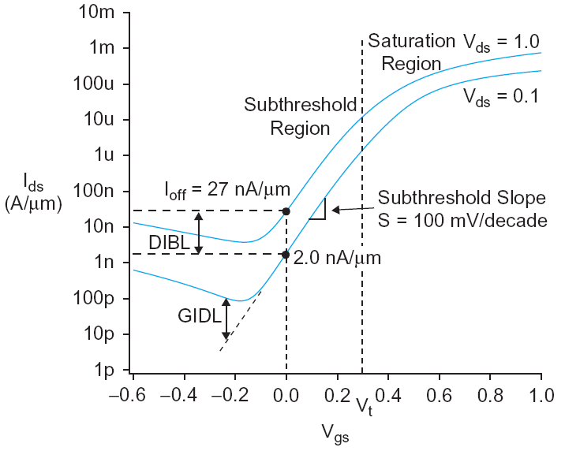
Junction Leakage
From reverse-biased p-n junctions
  Between diffusion and substrate or well
Ordinary diode leakage is negligible
Band-to-band tunneling (BTBT) can be significant
  Especially in high-V_{t} transistors where other leakage is small
  Worst at V_{db} = V_{DD}
Gate-induced drain leakage (GIDL) exacerbates
  Worst for V_{gd} = -V_{DD} (or more negative)
7: Power

Slide 32
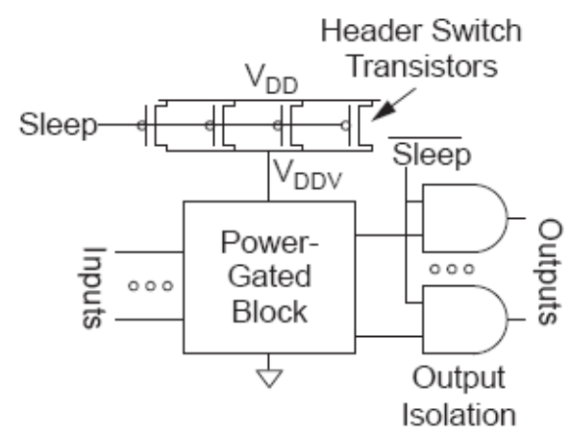
Power Gating
Turn OFF power to blocks when they are idle to save leakage
  Use virtual V_{DD} (V_{DDV})
  Gate outputs to prevent
  invalid logic levels to next block
Voltage drop across sleep transistor degrades performance during normal operation
  Size the transistor wide enough to minimize impact
Switching wide sleep transistor costs dynamic power
  Only justified when circuit sleeps long enough
7: Power

